Slide 1
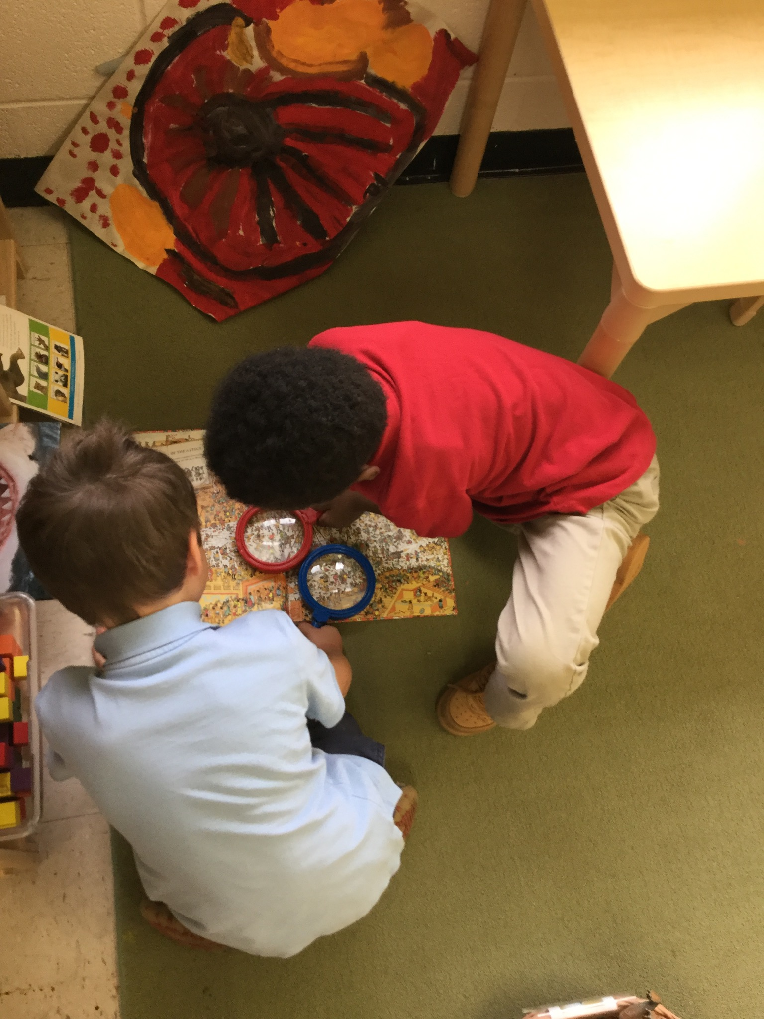
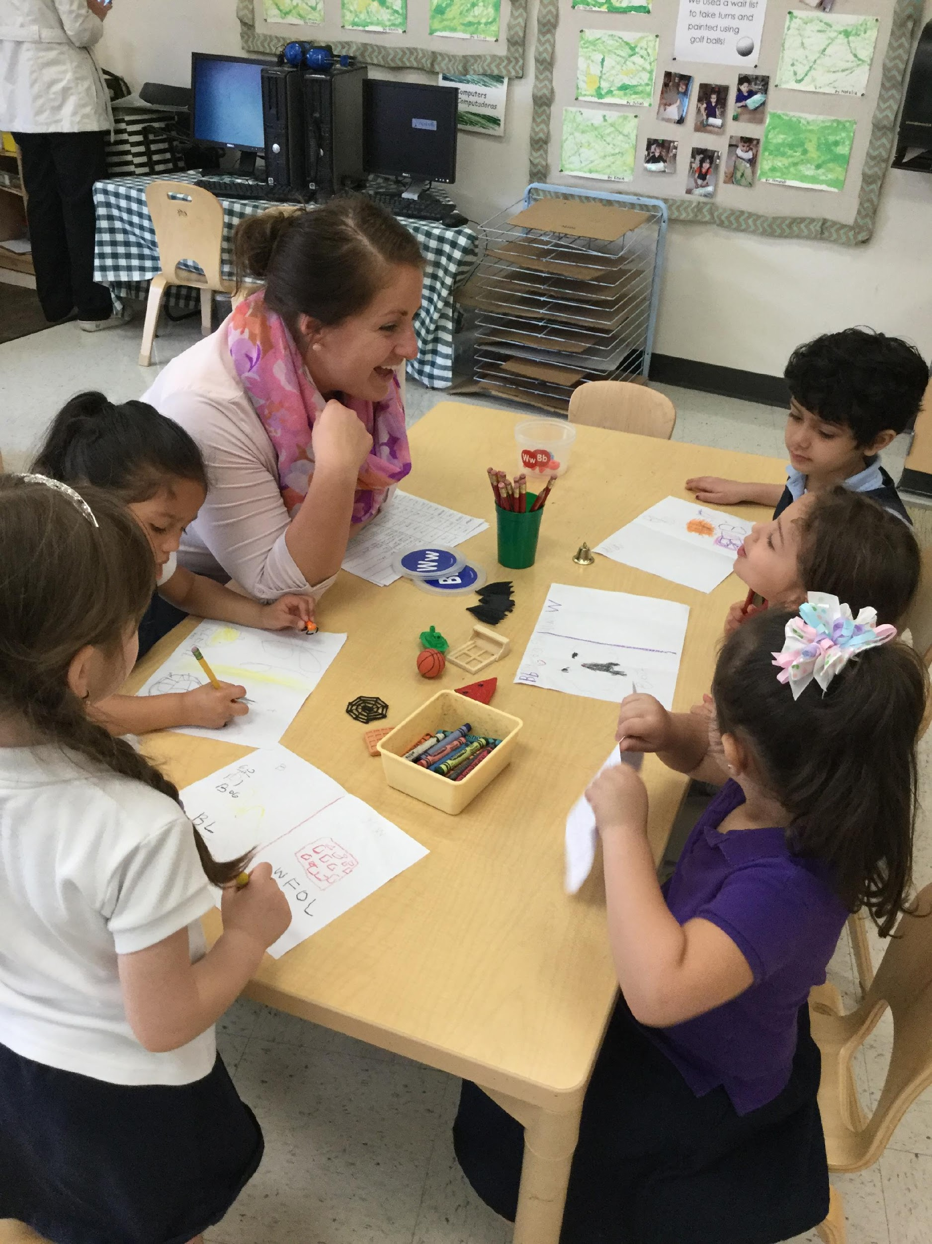
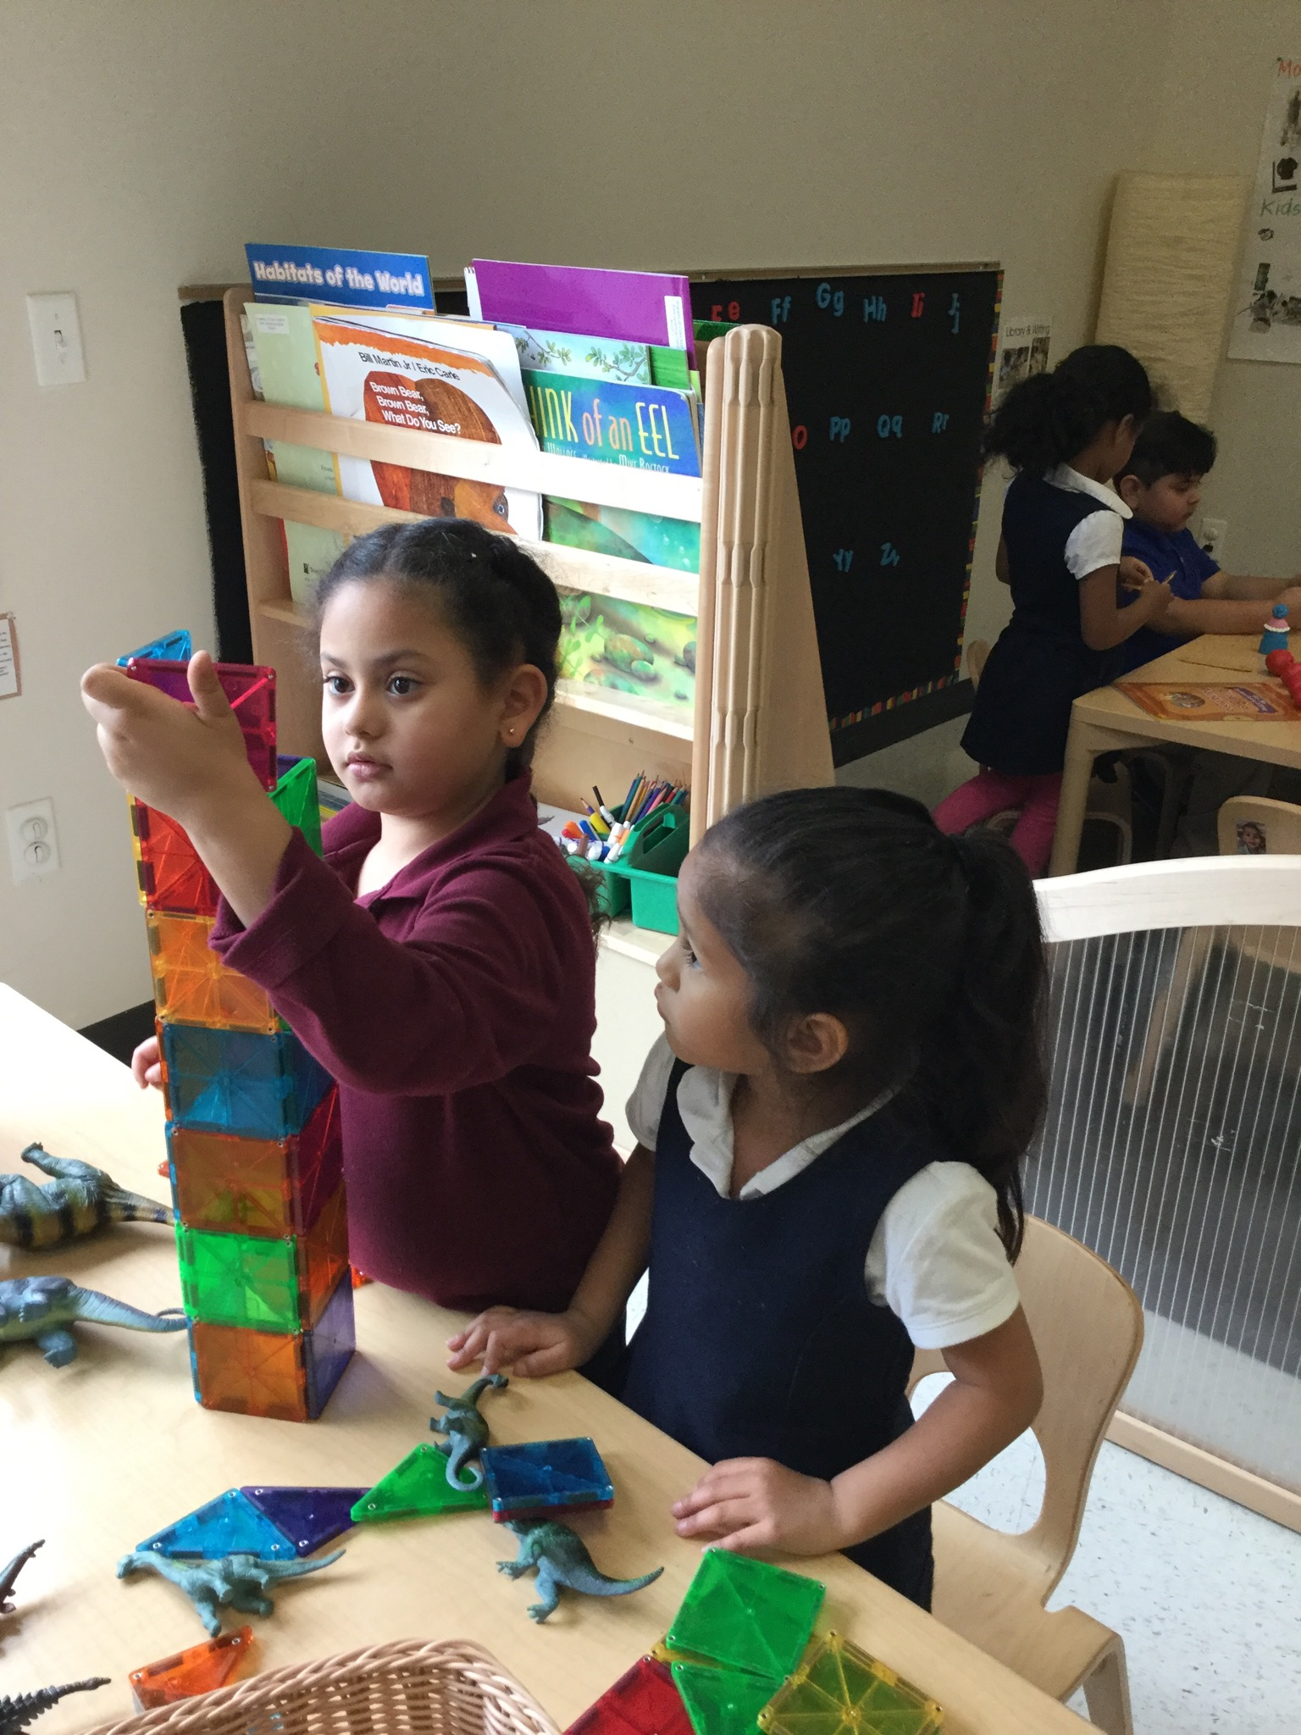
Increasing Teacher Listening & Child Talk
CHALK PROFESSIONAL DEVELOPMENT SERIES

Slide 2
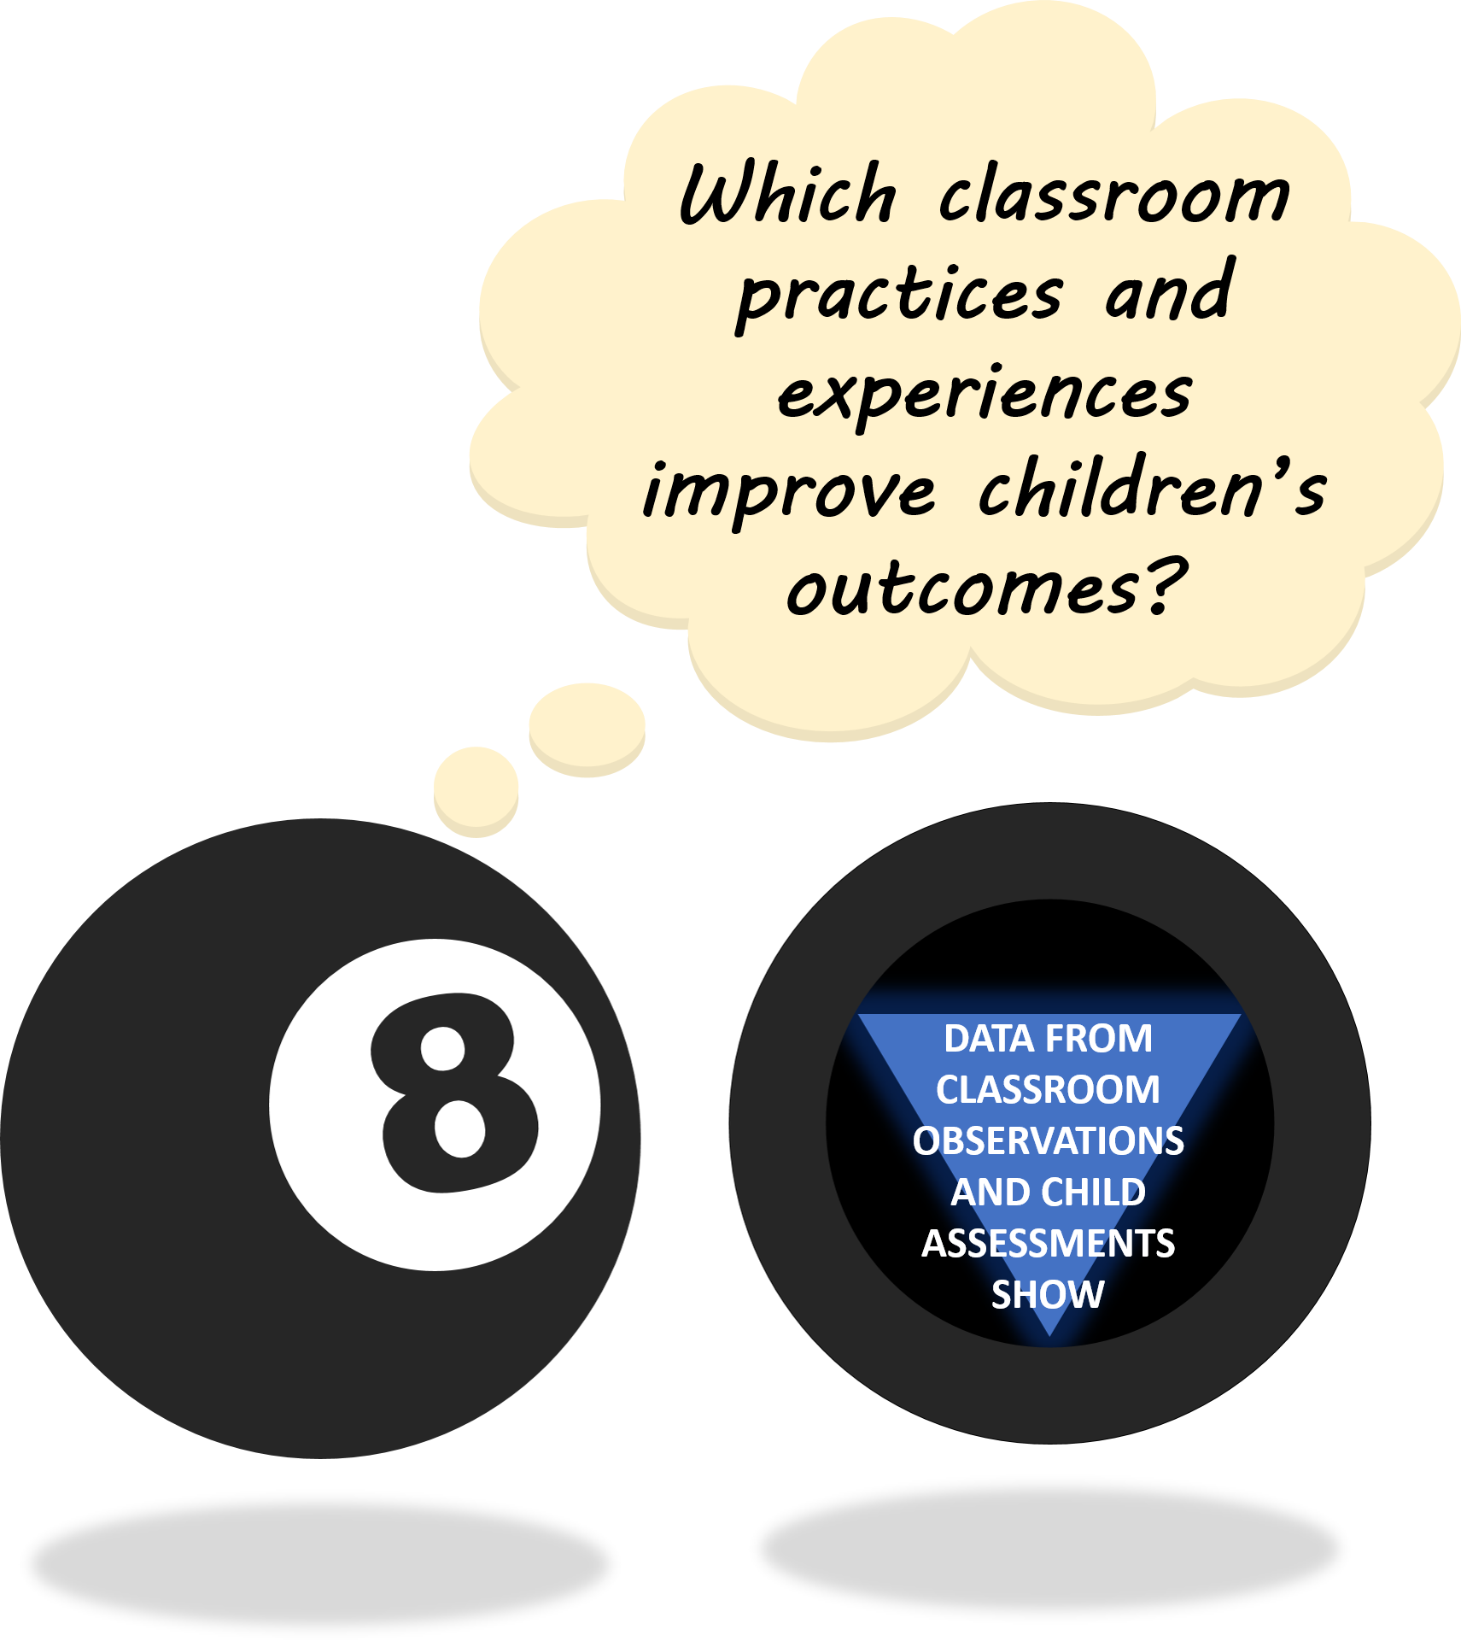
THE “MAGIC 8” CLASSROOM PRACTICES
Reduce time spent in transition
Improving level of instruction
Creating a positive climate
Increasing teacher listening to children
Planning sequential activities
Promoting associative and cooperative interactions
Fostering high levels of engagement
Providing math opportunities
★ 2017-18 Initiative: Focus on Literacy ★

Slide 3



WHY LISTENING TO CHILDREN MATTERS
Increased Teacher Listening leads to more opportunities for Child Talk.
Children in classrooms with teachers who listened more had greater gains in Math, Vocabulary, and Knowledge of Letters & Sight Words.
Children who were observed talking more frequently had greater gains in the above-mentioned skills and Self-Regulation.
SELF-REGULATION
LETTER & SIGHT WORD IDENTIFICATION
MATH
VOCABULARY
prosocial skills
Communication
These patterns were particularly true for children who entered pre-k with lower skills than their peers!
Notes:
ATLANTA SPEECH SCHOOL VIDEO – pause for discussion?
https://www.youtube.com/watch?v=F9HWlIQ1nZE

Slide 4

STRATEGIES FOR SUPPORTING CHILD TALK
ASK AUTHENTIC, OPEN-ENDED QUESTIONS
ALLOW WAIT TIME FOR RESPONSES
POSITIVELY ACKNOWLEDGE CONTRIBUTIONS
EXTEND AND ELABORATE UTTERANCES
ENCOURAGE CONVERSATION AMONG PEERS
PROVIDE SCAFFOLDS FOR CHILDREN WITH LIMITED LANGUAGE SKILLS
PROVIDE SCAFFOLDS FOR LOW-LANGUAGE
EXTEND AND ELABORATE UTTERANCES
DISCUSSION POINT:
Remember what if felt like when someone cared about what you thought when you were a child.
How can you create those opportunities for your students?

Slide 5
USE AUTHENTIC OPEN-ENDED QUESTIONS
What do you think about…
Ask questions that show children you really care about what they are thinking!
Avoid simple “yes” or “no” questions, or those with only one correct answer.
Book Discussion Cards provided by Creative Curriculum (or other curriculum) give excellent examples of open-ended questions to ask during or after read-alouds
Brainstorm question stems to post at adult height in different areas of the room
This relieves the pressure of having to come up questions on the spot
Strive for Five!
Aim for 5 conversational turns during exchanges with children
How can we…
Tell me about….
I wonder…
What would happen if…
What would you do…
?
How did you…
Notes:
NEED CITATION FOR STRIVE FOR FIVE
Don’t assume teachers will know the difference between open and closed-ended questions

Slide 6


ALLOW WAIT TIME FOR RESPONSES
Silence while waiting for a response during a group discussion can be overwhelming for teachers and children
Try setting up routines and expectations that encourage children to take time to think about their answers
“When I tell you to ‘think big’, I want you to take some time and think about your answer. Then, touch your nose to show me you are ready.”
It takes time for young children to process information and formulate responses!
DISCUSSION POINT:
Wasik & Iannone-Campbell (2012) p. 330
Do you find it challenging to practice wait time? Why?
Notes:
It’s not just about the question…it’s about what happens afterwards!
Wasik & Iannone-Campbell (2012)
Teachers’ typical wait time is about three seconds
Try providing a 15-second wait time, give children time to think and respond without silence of waiting becoming overwhelming

Slide 7
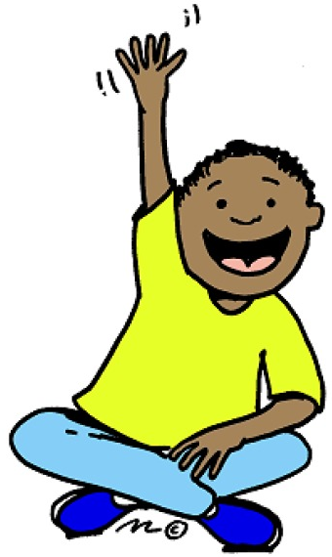
POSITIVELY ACKNOWLEDGE CONTRIBUTIONS
Speaking up can feel very risky for children who are shy or less skilled with language.
Keep this in mind, and be enthusiastic about their contributions to the exchange!
Remember the first rule of improvisational comedy!
“Yes, and…”
Differentiate your responses to off-topic comments.
For a child who often contributes:
Identify a link between child’s comment and current topic –OR-- Ask them to tell more about it later, and bring attention back to topic at hand.
Set aside a time for children to come talk to you.
For a child who rarely contributes:
Encourage participation and find a way to ask more questions
DISCUSSION POINT:
How can you use the “yes, and…” principle in your classroom?
Notes:
Off-topic comment activity

Slide 8
EXTEND & ELABORATE SHORT UTTERANCES
Follow children’s interest by observing their play before trying to engage in conversation
Echo what the child says and add on details
Model correct grammar without directly correcting children
Particularly useful for ELL children
CHILD: I drive car.
TEACHER: You are driving the car down the road!
TEACHER: Wow, you think the Wolf went to the house made of stone and blew it down? Hmm…What do you think would happen if he couldn’t blow the house down?
CHILD: The Wolf goed to the other house made of rocks and he blewed it down too!
DISCUSSION POINT:
What is one activity or time of the day when you could use “extend and elaborate” strategies with an individual child?
Notes:
Instead of correcting children when they say something factually or grammatically incorrect, use your response to extend children’s utterances into complete sentences and provide additional detail

Slide 9


ENCOURAGE CONVERSATION AMONG PEERS
How can we show Charlotte we care about what she’s saying?
Teach children how to actively listen to what others are saying
Keep eyes on the speaker (even if it means turning around)
Do not talk while the speaker is talking
Highlight and compare children’s responses
“Selah, your idea sounds different from Cameron’s…”
Suggest questions for peers to ask each other
“Jayla, why don’t you ask Tyler to tell you what he likes to do when he’s wearing his new shoes. “
Turn & Talk / Shoulder Partners
“Turn to your Shoulder Partner and tell them…”
Call on a few children to share their friends’ responses
DISCUSSION POINT:
What expectations have you established for speaking and listening during group time?
MY TURN TO TALK
MY TURN TO LISTEN
Notes:
Children may be familiar with the group time expectations “eyes are watching, ears are listening…”, but are they used to extending that courtesy to teachers and peers?

Slide 10

PROVIDE SCAFFOLDS FOR CHILDREN WITH LIMITED LANGUAGE SKILLS
Use picture cards to help children make requests or tell stories
CHILD: Points to “snack” card. TEACHER: “You want a delicious snack?”
Pair common phrases with sign language or translations from children’s home language
Children’s families can be excellent resources to help bring multilingual materials into the classroom
Use predictable phrases or songs to elicit utterances
TEACHER: Ready, set…
CHILD: /g/
TEACHER: That’s right, GO!
DISCUSSION POINT:
Do you make a conscious effort to engage children with lower language skills in verbal interactions? How?
Notes:
*accept utterances as part of the verbal exchange…

Slide 11
HENNY PENNY BOOK DISCUSSION: ROLE PLAY
Creative Curriculum discussion cards provide some wonderful questions for checking children’s comprehension and promoting discussion!
So, let’s practice!
Each group has a copy of the discussion questions provided for Henny Penny
One teacher and 3-4 children for each group
“Children” will choose a role from a hat (don’t tell your group!)
“Teachers” will ask some of these questions and practice strategies for promoting conversation about the story (feel free to orient “children” to the story elements as needed ☺)
You can shift roles as time permits

Slide 12
HENNY PENNY BOOK DISCUSSION: ROLE PLAY
Child Roles:
I REALLY want to tell you about these worms I found one time. | I don’t like this story. | The teacher is not listening to me, so I’m going to tell my idea to my neighbor. | I have to go to the bathroom. | I’m getting frustrated because my friends keep talking over me. | I have soooo many questions for you.
I’m excited about the story, but I have a misconception. | I’m distracted/off-task because I don’t understand the question. | I make spontaneous personal experiences or another text. | My responses are thoughtful but very hard to hear. | I want to answer EVERY question. | I need help finding words to express my idea.

Slide 13

SPECIAL THANKS & ADDITIONAL RESOURCES
We are grateful to the following MNPS Pre-K Instructional Coaches and Multi-Classroom Leaders for their invaluable feedback in developing these materials:
SeTara DeThrow
Carrie Head
Susan McClain
Stephanie Mullins
Holly Stone
Ashley Aldridge Wilson
Rhiannon Wilson
https://my.vanderbilt.edu/mnpspartnership/

Slide 14
INDIVIDUAL IMAGE SOURCES
FREQUENTLY USED IMAGES*
ADDITIONAL IMAGE SOURCES
Lightbulb | myiconfinder.com
Designed by Vexels.com:
Hand drawn magnifying glass
Hand drawn bar graph
Pie chart hand drawn doodle
Hand drawn wall clock
Hand drawn cloud bubble
Hand drawn open book
Cog wheel hand drawn icon
Slide 3: Mouth & ear | clipartpanda.com
Slide 6: Child gear head | DeviantArt.com
Slide 7: Boy raised hand | clipart-library.com
Slide 10: Wooden ladder | clipartextras.com
*These graphics are used as icons throughout the series. For example this lightbulb clipart appears beside most “Discussion Point” questions.

Slide 15
References
Reese, E., Leyva, D., Sparks, A., & Grolnick, W. (2010) Maternal elaborative reminiscing increases low-income
children’s narrative skills relative to dialogic reading. Early Education and Development, 21(3), 318-342.
DOI: 10.1080/104092892010481552
Wasik, B.A. & Iannone-Campbell, C. (2012) Developing vocabulary through purposeful, strategic conversations.
The Reading Teacher, 66(2), 321-332. DOI:10.1002/TRTR.01095

